Slide 1
6. Company Hiring Behavior & Industry Dynamics
Scenario: “Your client is an investor analyzing which companies are hiring aggressively in tech.”
Source: https://colab.research.google.com/drive/1hFRpscNz9yd6rDwyvU3O8r1RCAge_Exa?usp=sharing

Slide 2
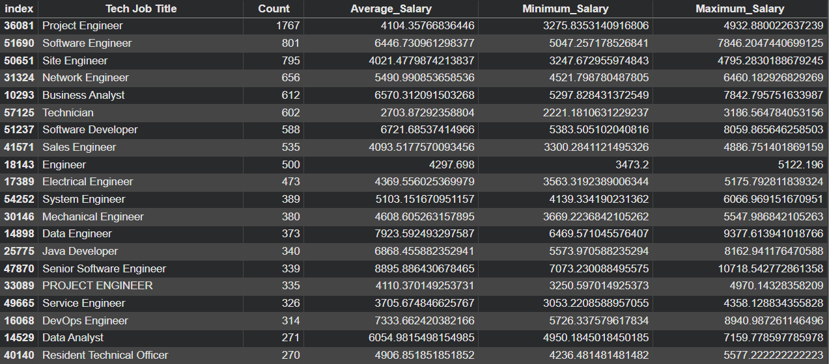
Top 20 Tech Job

Slide 3
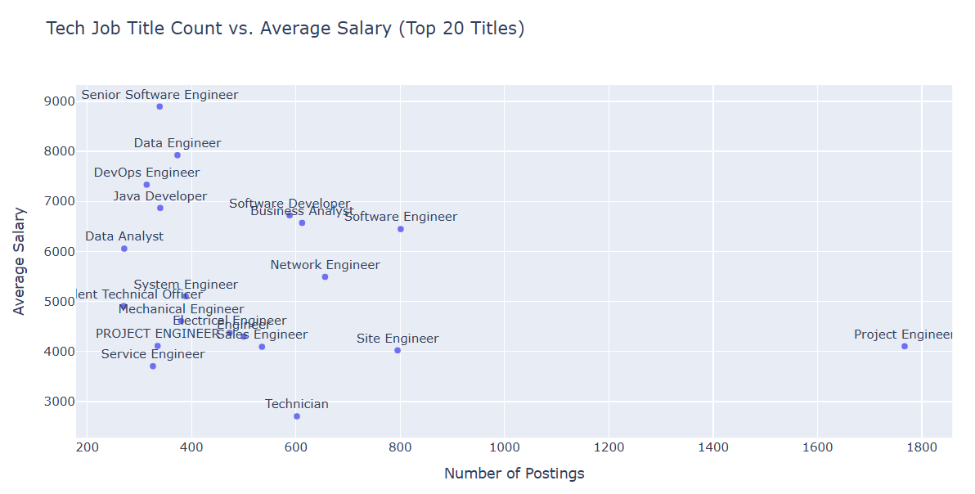

Slide 4
Industry Dynamics

Slide 5
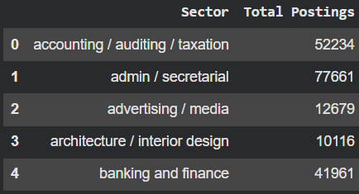
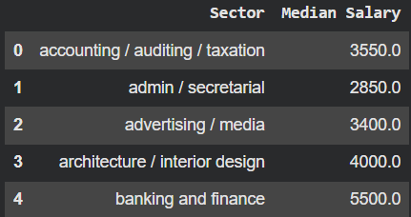
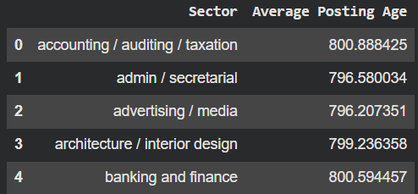
Calculate total postings per sector
Calculate median salary per sector
Analyze growth trend per sector

Slide 6
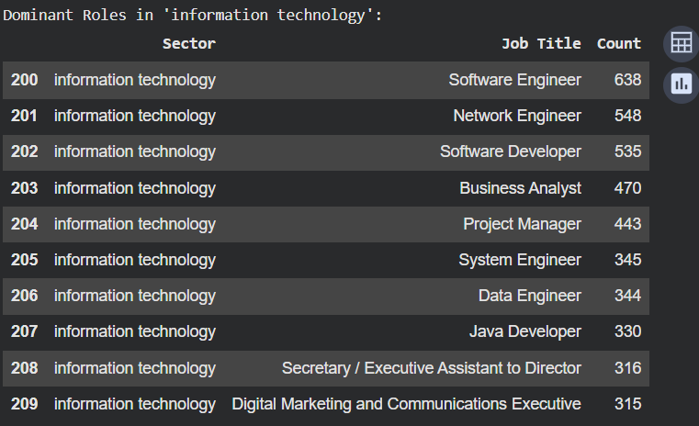
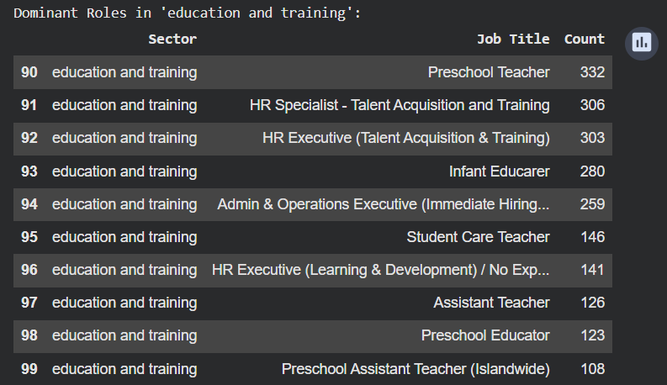
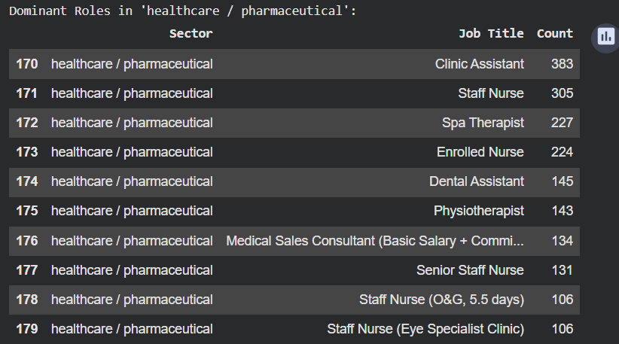
Identify trending and declining sectors

Slide 7
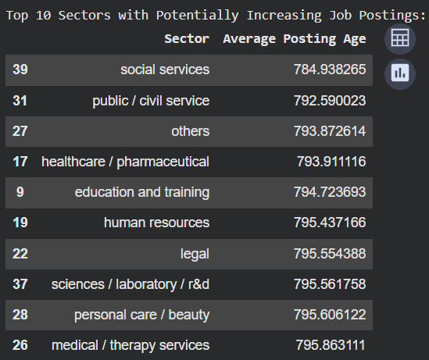
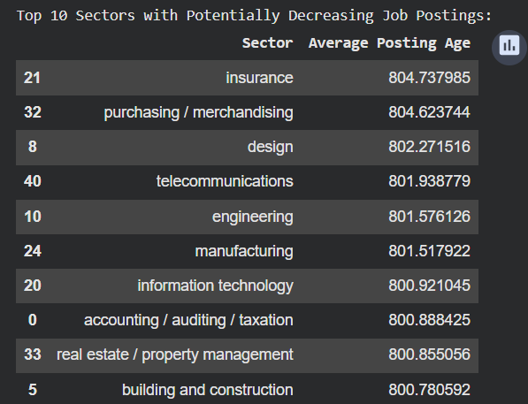
Identify trending and declining sectors

Slide 8
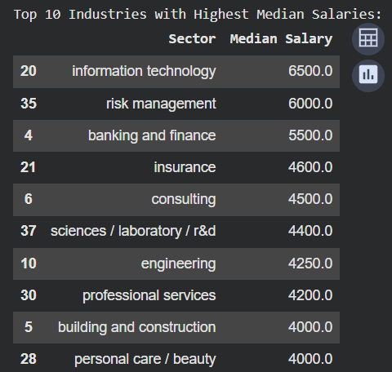
Identify top-paying industries

Slide 9
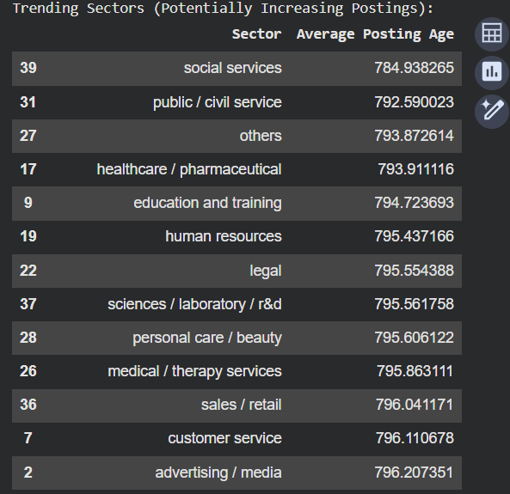
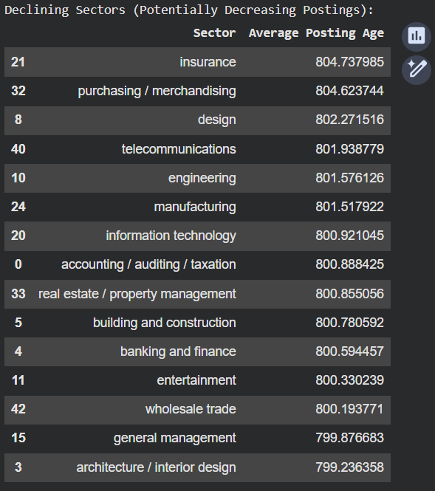
Trending sectors, declining sectors, and top-paying industries.

Slide 10
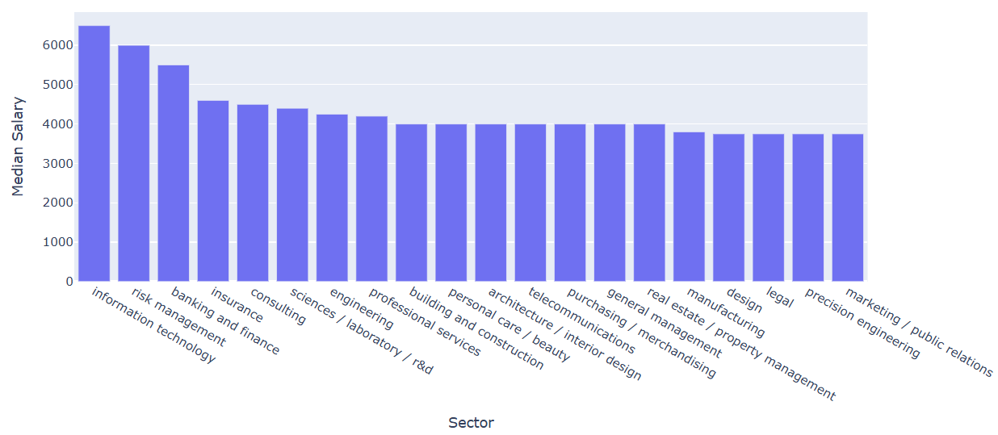
Top 20 Sectors by Median Salary

Slide 11
